Slide 2
App Dev with Documents, their Schemas and Relationships
Tugdual Grall
Technical Evangelist

Slide 3
Agenda
More about aggregates and JSON
  What are schemas in a Document Database?
The modeling behind our sample database
  Document structure, metadata in Couchbase Server
  An example of how to handle new requirements as needed
  Addressing concurrent modifications to documents

Slide 4
Flexible Schema

Slide 5
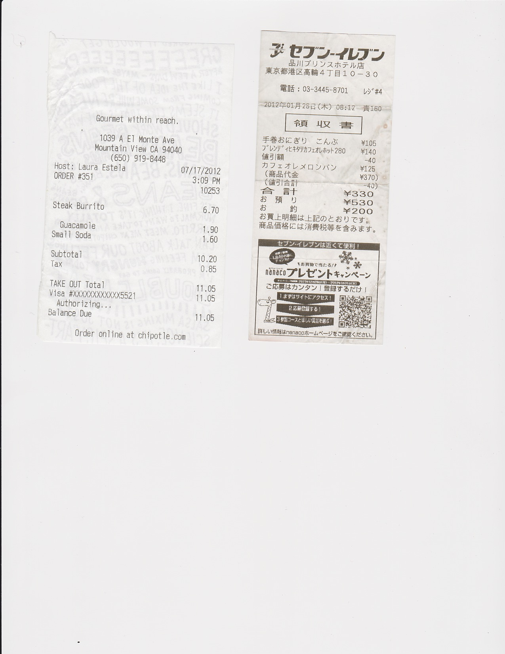

Documents and Schema
Couchbase is not schema-less, documents have an implicit schema.
We’re going to be big in Japan!

Slide 6
Schema Updates: Techniques
Add the additional fields to new documents as they arrive
  Clearly, comes with an application level upgrade
Define a sane default for this new field for record retrievals where the record doesn’t exist
  Example: adding loyalty points to the receipt- default to 0 points
May need to incorporate fields to assist with processing:
  A docType for use in control processing:
  “docType”: “receipt”
  Versioning of documents for application to upgrade a document

Slide 7
Document Structure,
Extending Documents

Slide 8
JSON Documents
Map more closely to your application’s external API
CRUD Operations, lightweight schema
Stored under an identifier key
{
“fields” : [“with basic types”, 3.14159, true],
“like” : “your favorite language”
}
client.set(“mydocumentid”, myDocument);
mySavedDocument = client.get(“mydocumentid”);

Slide 9
Meta + Document Body
{
"brewery": "New Belgium Brewing",
"name": "1554 Enlightened Black Ale",
"abv": 5.5,
"description": "Born of a flood...",
"category": "Belgian and French Ale",
"style": "Other Belgian-Style Ales",
"updated": "2010-07-22 20:00:20"
}
{
"id" : "beer_Enlightened_Black_Ale”,
...
{
Document
user data,
can be anything
“vintage” date format from an SQL dump >_<
unique ID
Metadata
identifier,
expiration, etc
Notes:
legacy or external data formats is the new normal (timestamp)
explain about meta in views

Slide 10
Handling New Requirements

Slide 11
Have you ever…
Needed to update your schema in a large database?
  It can quite literally take months.
Needed to go re-visit the data model with the team because requirements changed?
  Happens frequently, and can frequently end up using a separate database, then a challenge to keep data linked.
  Things like Rails migrations are awesome ways to address this problem, but it’s better to not need to do it at all.

Slide 12
Beer sample database
The beer database is based on this kind of flexible schema
  Not all beers have all attributes and some may have unique attributes
  Still, there tends to be a common schema, since they came from the same application
Different document types
  While all are JSON, there do tend to be different entity types represented in our set of JSON. Common approach is to add an attribute to define type, such as “type”: “beer”.
    Breweries and Beers
Document relationships
  While it’s not a relational database, there are relationships: Beers, Breweries, Locations and others yet to be added.
    Constraints are enforced in most real world applications at the app level, not the database level.

Slide 13
Let’s Add Comments and Ratings to the Beer
Challenge linking items together
Whether to grow an existing item or store independent documents
No transactionality between documents!
good w/ burgers
{
"brewery": "New Belgium Brewing",
"name": "1554 Enlightened Black Ale",
"abv": 5.5,
"description": "Born of a flood...",
"category": "Belgian and French Ale",
"style": "Other Belgian-Style Ales",
"updated": "2010-07-22 20:00:20"
}
I give that a 5!
tastes like college!

Slide 14
Let’s Add Comments and Ratings to the Beer
We’ll put comments in their own document
And add the ratings to the beer document itself.
{
"brewery": "New Belgium Brewing",
"name": "1554 Enlightened Black Ale",
"abv": 5.5,
"description": "Born of a flood...",
"category": "Belgian and French Ale",
"style": "Other Belgian-Style Ales",
"updated” : "2010-07-22 20:00:20",
“ratings” : {
“525” : 5,
“30” : 4,
“1044” : 2
},
“comments” : [
“f1e62”,
“6ad8c”
]
}
{
"type": "comment",
"about_id": "beer_Enlightened_Black_Ale",
"user_id": 525,
"text": "tastes like college!",
"updated": "2010-07-22 20:00:20"
}
I give that a 5!
Notes:
here is a comment doc and some per-user ratings on the beer doc

Slide 15
Do it: save the comment document
Set at the id “u525_c1”
client.set(“u525_c1”,{
});
create a new document
"type": "comment",
"about_id”: "beer_Enlightened_Black_Ale",
"user_id": 525,
"text": "tastes like college!",
"updated": "2010-07-22 20:00:20"
{
"id": "u525_c1"
}

Slide 16
Link between comments and beers
"name": "1554 Enlightened Black Ale",
"abv": 5.5,
"description": "Born of a flood...",
"category": "Belgian and French Ale",
"style": "Other Belgian-Style Ales",
"updated": "2010-07-22 20:00:20",
“ratings” : {
“525” : 5,
“30” : 4,
“1044” : 2
},
“comment_ids” : [
“u525_c1”,
“6ad8c”
]
}
{
"type": "comment",
"about_id": "beer_Enlightened_Black_Ale",
"user_id": 525,
"text": "tastes like college!",
"updated": "2010-07-22 20:00:20"
}
link to beer
{
"id": "u525_c1"
}
link to comments
16
Notes:
say “meta” and document” on the thing
links in both directions mean if you have a beer in hand you can easily get to all it’s comments
link from comment to beer may be optional, as you can always create a view to facilitate that lookup
(it’s all about what your main user interaction flow requires)

Slide 17
How to: look up comments from a beer
SERIALIZED LOOP
beer = client.get(“beer:A_cold_one”);
beer.comment_ids.each { |id|
comments.push(client.get(id));
}
FAST MULTI-KEY LOOKUP
beer = client.get(“beer:A_cold_one”);
comments = client.multiGet(beer.comment_ids)
ASYNC VIEW QUERY
comments = client.asyncGet(“myapp”,“by_comment_on”,
{:key => “beer:A_cold_one”});
Notes:
multiget is parallel enough to matter, only when you have more keys in a batch than you have nodes in your cluster,
it never hurts to use, so with any set of user objects, it’s best to use multiget for maximum performance

Slide 18
Concurrency Problem: Adding Ratings
Other users are ratings beers also, so we use a CAS update
  we don’t want to accidentally overwrite another users rating that is being saved at the same time as ours
Retry the operation, if appropriate
  Also useful if you have internal structure that you want to maintain
cb.cas("mykey") do |doc|
doc["ratings"][current_user.id] = my_rating
doc
end
Actor 1
Actor 2
Success
CAS mismatch & retry
Couchbase Server
Notes:
TODO: fix this slide, not sure what chris was going for here. fixed already: ruby blocks

Slide 19
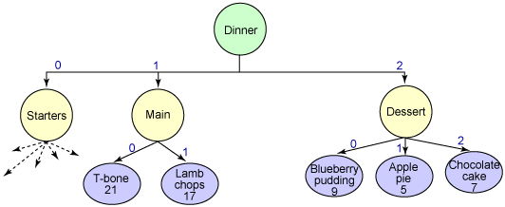
Object Graph With Shared Interactive Updates
Challenge: higher level data structures
Objects shared across multiple users
Mixed object sets (updating some private and some shared objects)
Only marginally related figure courtesy of http://www.ibm.com/developerworks/webservices/library/ws-sdoarch/
Notes:
the general case ... a full dinner!
what is your user interaction flow... chef vs patron vs waiter. support all 3.?
which are the most performance critical sections?
publishing the evenings menu is OK to take a few seconds,
but marking an item as out of stock needs to be fast
waiter inputting orders needs to be fast, need latest data always
customer browsing menu is OK to see a few seconds old version

Slide 20

Get With Lock (GETL)
Often referred to as “GETL”
Pessimistic concurrency control
Locks have a short TTL
Locks released with CAS operations
Useful when working with object graphs
Still only marginally related figure courtesy of http://www.ibm.com/developerworks/webservices/library/ws-sdoarch/
Notes:
why would you use a lock?
assuming all your operations are idempotent: ONLY when the cost of CAS failure is greater than the cost of setting the lock.
locking is only an optimization, provides no transactional boundaries.

Slide 21
Couchbase in Summary
  Couchbase has Flexible Schema
  Schema is implicit per document. This makes it easier to model entities.
  Document Structure Relationships
  Couchbase stores metadata with documents. Documents do have relationships, even though it is not relational.
Extending your Document Requirements
Extending your document structure is simple, but you may need to consider a few things when deciding how to do so. In document, or separate documents?
Notes:
Mention in summary…
Also, note there are other systems such as Hadoop, Elastic search that have a lot of merit to add,
and there are system like relational databases that don’t adddress contemporary needs

Slide 22
Q&A

Slide 23
Thanks!

